Slide 1
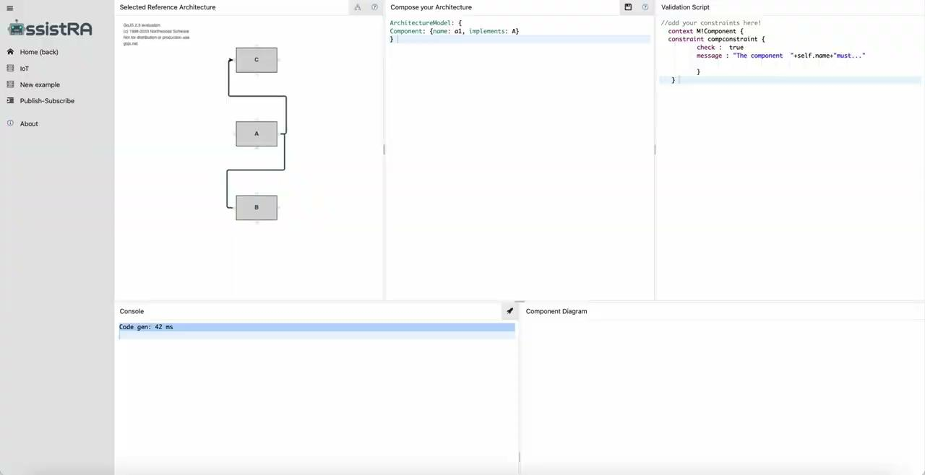
Continuous conformance checking

Slide 2

Partial conformance checking

Slide 3
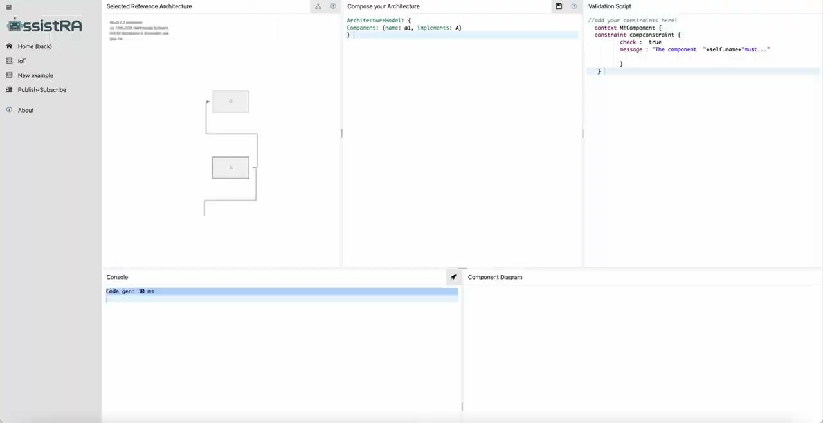
Restrictive conformance checking

Slide 4
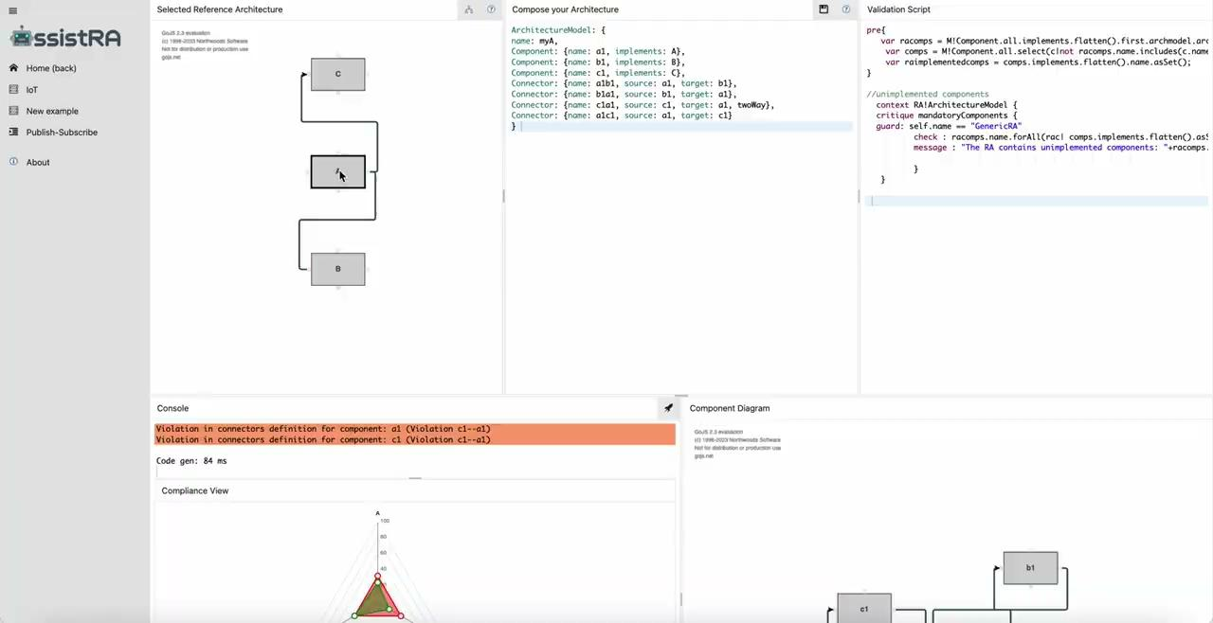
Architecture-specific constraints declaration

Slide 5
Multi-level conformance: style declaration

Slide 6
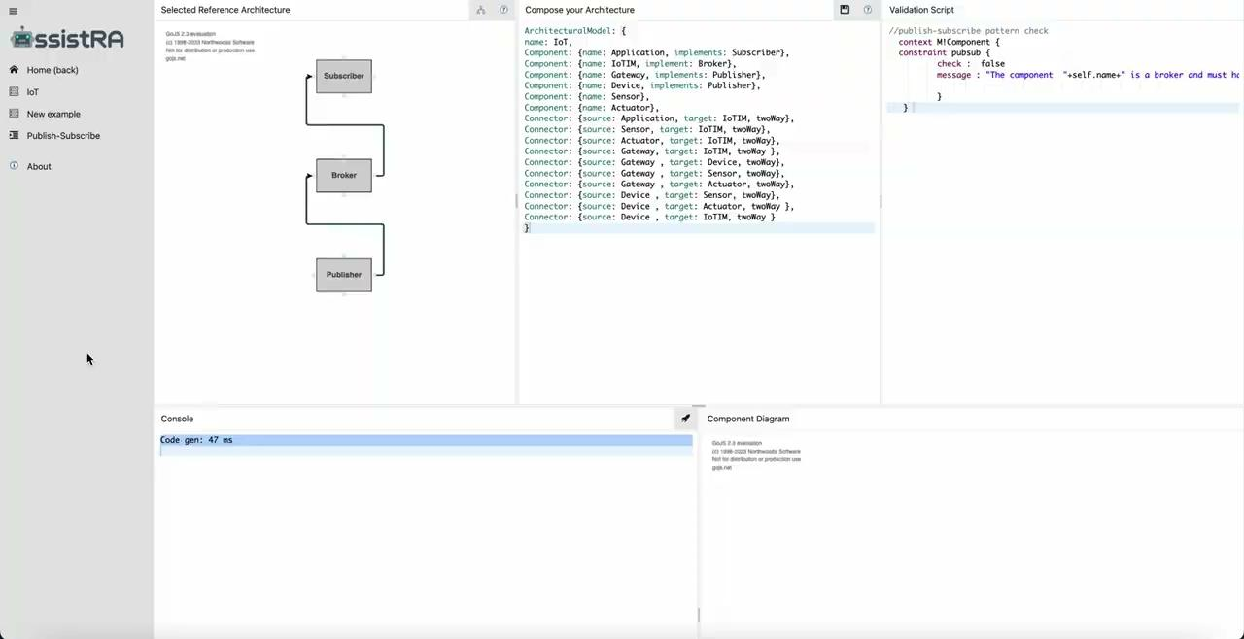
Multi-level conformance: RA selection and myA composition

